Slide 1
Upright Orientation of Man-Made Objects
SIGGRAPH
2008
Hongbo Fu(1) Daniel Cohen-Or(2) Gideon Dror(3) Alla Sheffer(1) | (1)University of British Columbia (2)Tel Aviv University (3)The Academic College of Tel-Aviv-Yaffo

Slide 2
Outline
Introduction
System overview
Selecting candidate base
Feature extraction
Assessment function
Results
Conclusion

Slide 3
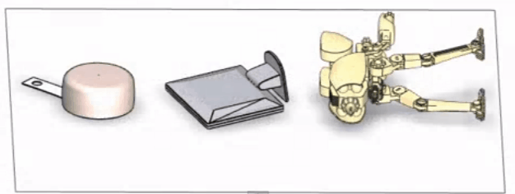
Introduction
Automatic detection of upright orientation for commonly used 3D geometric shapes.
Infer objects upright orientation by analyzing geometry.

Slide 4
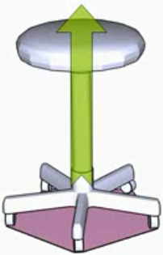
System Overview
Notes:
The objects are stand on a flat surface, each of them has a natural base.

Slide 5
System Overview
Notes:
Extract a set of candidate bases by analyzing the object’s convex hull.

Slide 6
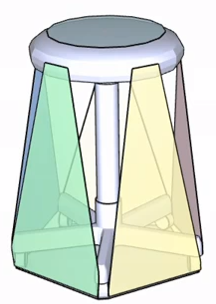
System Overview
7 candidate bases
Notes:
Extract a set of candidate bases by analyzing the object’s convex hull.

Slide 7
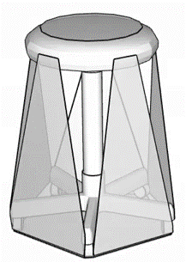
System Overview
7 candidate bases
Stability
Symmetry
Parallelism
Visibility
Notes:
Assign them geometric attributes, which convey information that distinguishes the natural base.

Slide 8
System Overview
7 candidate bases
Stability
Symmetry
Parallelism
Visibility
Assessment Function
Random Forest
+
SVM
Notes:
Combine a RF and a SVM to be the assessment function.

Slide 9
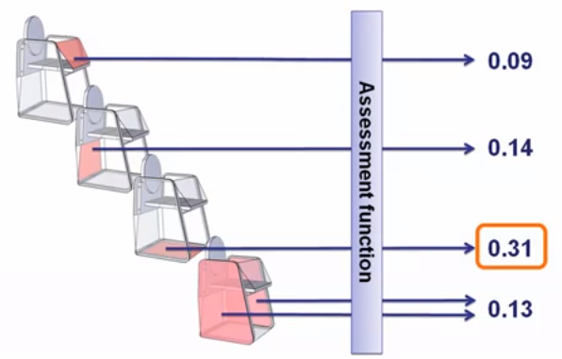
System Overview
7 candidate bases
Stability
Symmetry
Parallelism
Visibility
Assessment Function
Random Forest
+
SVM
Notes:
Each candidate base of an object is scored and upright orientation is finally determined by the highest score.

Slide 10
Selecting candidate base
A candidate base is a set of coplanar points on the model lying on its convex hull.
Notes:
1.Each base defines a supporting plane.
2.Define the supporting polygon of a base as 2D convex hull of the base points in the supporting plane.

Slide 11
Selecting candidate base
A candidate base is a set of coplanar points on the model lying on its convex hull.
Merge coplanar hull facets using Variational Shape Approximation.
Notes:
1.Each base defines a supporting plane.
2.Define the supporting polygon of a base as 2D convex hull of the base points in the supporting plane.
3.Compute the center of mass as the weighted average of the face barycenter of the mesh.
4. For each candidate base we check whether the projection of the center of mass to the supporting plane is inside the supporting polygon and discard the candidates for which the projection is outside.

Slide 12
Feature extraction
Develop a set of geometric attributes that reflect functional design considerations.
Geometric attributes convey information that distinguishes the natural base from the other candidate base.
Every candidate base obtain 8 features, which are passed to our learning algorithm.

Slide 13
Feature extraction
Static Stability
dinner(θ)/douter(θ) , 0 ≤ θ< 2 π
dinner(θ): the distances from center of mass to the boundary of supporting polygon.
douter(θ): the distances from center of mass to the boundary of projected hull.
Projected hull
Center of mass
Supporting polygon
Notes:
1. b2 and b3 better than b1.
2. b2 has worse stability than b1.

Slide 14
Feature extraction
Symmetry
Coincidence distance: the average distance of the four points to their centroid.
Collinearity distance: the average distance of the four points to their least-squares best-fit line.
Center of mass
Barycenter of supporting polygon
Barycenter of convex hull
Barycenter of actual base
Notes:
1. b1 and b3 better than b2.
2. b1 and b2 have same degree of symmetry.

Slide 15
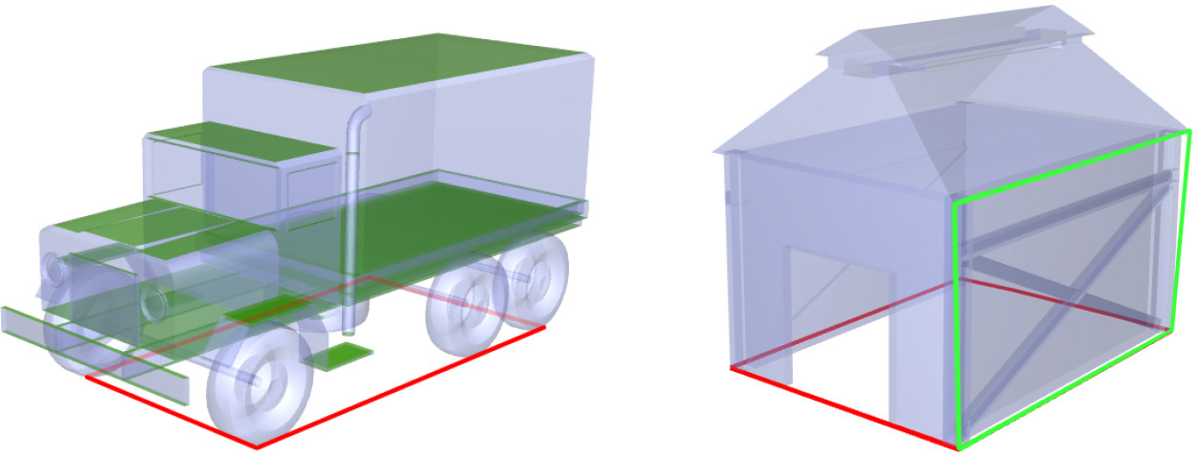
Feature extraction
Parallelism
Face parallelism: measured the area of model faces that parallel to the supporting plane.
Base parallelism: measured the area of other supporting polygons that are parallel to the reference supporting polygon.

Slide 16
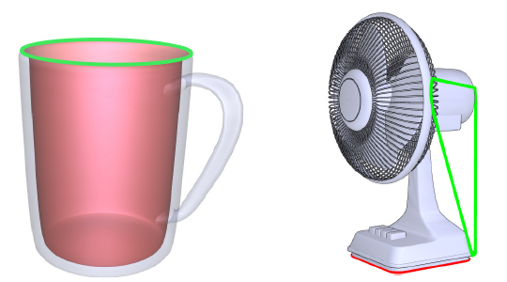
Feature extraction
Visibility
Per-face visibility: render the model from 32 uniformly sampled view directions with each face assigned a distinct color and then count the number of hits per face.
Per-base visibility: compute the sum of area of visible faces.

Slide 17
Assessment function
Training set of man-made models using the Princeton Shape Bench-mark.
345 unique training models with around five candidate bases per model.
Manually labeled the candidate bases is natural or not.

Slide 18
Assessment function

Slide 19
Assessment function

Slide 20
Results
Validation
Prediction accuracies with different learning methods.

Slide 21
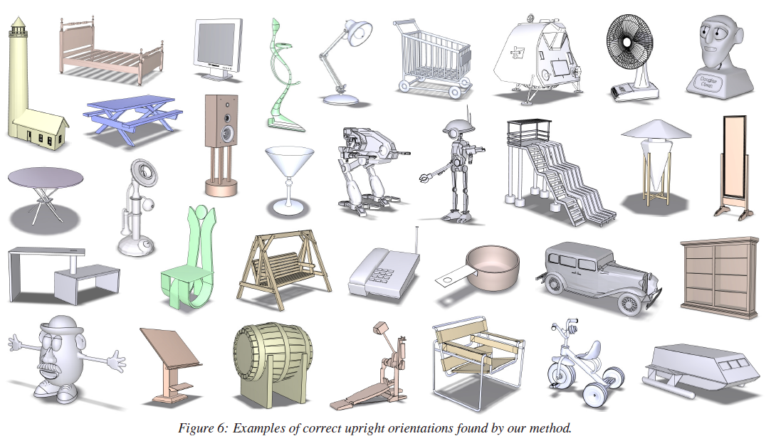
Results
Correct upright orientations

Slide 22
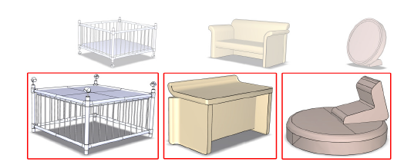
Results
Incorrect upright orientations
Misorient about 10% of the models tested.

Slide 23
Results
Validation
Average model statics and timing

Slide 24
Conclusion
Provide an effective solution to upright problem.
By selecting the best orientation form a small set of candidates determined from model geometry alone.
Theoretically, it might be possible to further improve prediction accuracy by exploring additional geometric attributes.
Notes:
Necessary geometry attributes for orientation discrimination are largely unrelated to specific model shapes.

